Slide 1
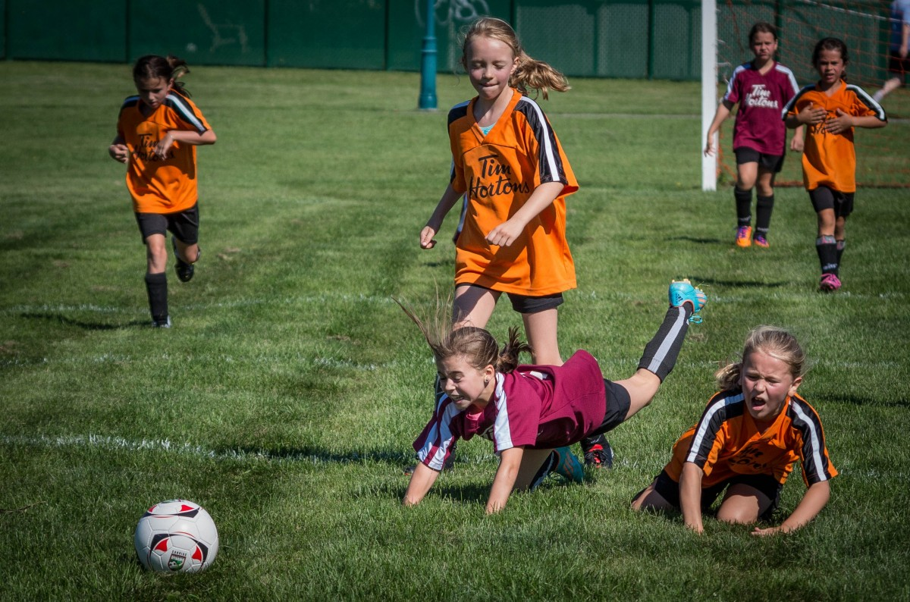

UNIT 1 & 2 − Motor Learning and Coaching 2nd ed.
https://pxhere.com/en/photo/1182362

Slide 2
UNIT 1 & 2 − Motor Learning and Coaching 2nd ed.
COPYRIGHT
© PE Studies Resources 2019.
All rights reserved.
No part of this publication may be reproduced, stored in a retrieval system or transmitted in any form by any means whatsoever without the prior permission of PE Studies Resources.
DISCLAIMER
This product has been developed to assist teachers in the delivery of the Unit 1 & 2 WACE Physical Education Studies course. It represents the authors’ interpretation and approach and is not endorsed by any governing body. Every effort has been made to ensure the accuracy of the information in this PowerPoint. PE Studies Resources cannot take responsibility for any claim, loss, damage or liability arising from the use of, or reliance on, the information contained in this resource.

Slide 3
CONTENTS
Introduction to Motor Learning
Classification of Motor Skills Gross and Fine motor skills Discrete, Serial and Continuous motor skills Closed and Open motor skills Simple and Complex motor skills
Phases of Motor Learning Cognitive Associative Autonomous
Phases of Information processing during skill performance Identification of stimuli/input Response identification/decision making Response/output Feedback
Types of cues used to improve performance Visual Verbal Proprioceptive

Slide 4
CONTENTS
Feedback Purpose of feedback Motivation Reinforcement Types of feedback Intrinsic Extrinsic Concurrent Terminal Non verbal Verbal Characteristics of effective feedback
Factors affecting skill acquisition Age Skill level Fitness level Injury Level of competition Type of activity
References

Slide 5
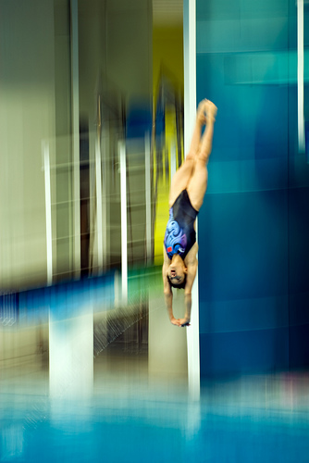
CLASSIFICATION OF motor SKILLS
Classification of motor skills
gross
fine
open
closed
discrete
serial
continuous
School Curriculum and Standards Authority. Physical Education Studies ATAR Year 11 Syllabus, 2016.
www.flickr.com/photos/cmaccubbin/2796382198/in/set-72157606953902842/
Home

Slide 6
CLASSIFICATION OF motor SKILLS
Classification of Movement Skills
Predictability of the Environment
Open
Type of Movement
Movement Precision
Closed
Fine
Gross
Discrete
Continuous
Serial
Home

Slide 7
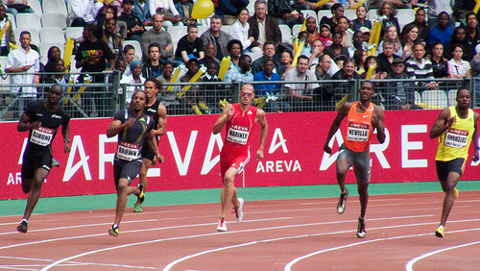
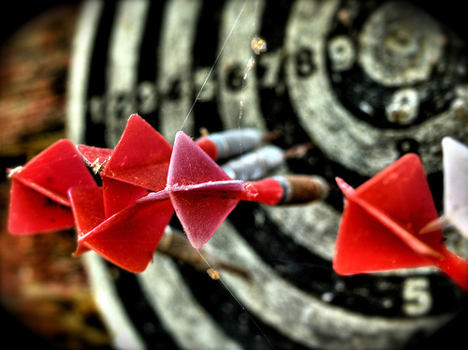
CLASSIFICATION OF motor SKILLS
This continuum is influenced by the size of muscle groups / movements
involved.
Gross Motor Skills
Involve movement of major muscle groups resulting in large body part movement
Includes fundamental movement patterns e.g. walking, running, balance, coordination, jumping
Fine Motor Skills
Involve movement of smaller muscle groups resulting in more precise movement
Includes activities such as writing, typing on a keyboard, playing a guitar
Often involves coordination between the hands and eyes
Movement Precision
Gross motor skill
www.flickr.com/photos/la_bretagne_a_paris/3735716413/in/set-72157621481525519/
Fine motor skill
www.flickr.com/photos/wili/214316359/in/set-72157606312639319/
Home

Slide 8
CLASSIFICATION OF motor SKILLS
Small amount of force exerted by the muscles
e.g. threading a needle, typing, writing
GROSS MOTOR SKILLS
Large amount of force exerted by the muscles
FINE MOTOR SKILLS
Precise movements
Often involves coordination between the hand and the eyes
Involves use of large muscle groups
Involves use of small muscle groups
Whole body movements
Requires coordination of large muscle groups to coordinate movements
e.g. running, walking, striking, kicking
Home

Slide 9
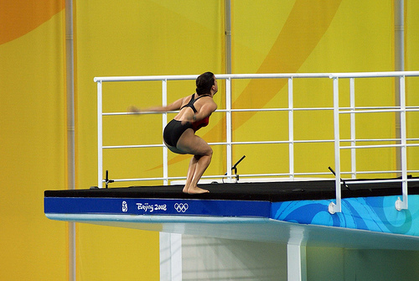
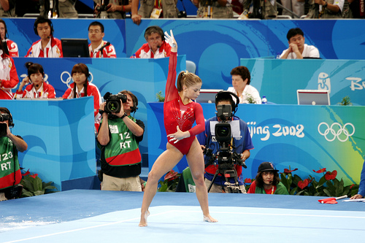
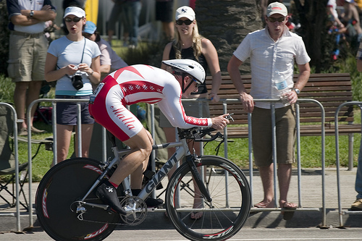
CLASSIFICATION OF motor SKILLS
This continuum is influenced by how well defined the beginning and end of the performance is.
Discrete Skills
Have clear beginnings and endings
E.g. a drive in golf, shot at goal, dive from the platform
Serial Skills
Made up of a number of discrete skills which are put together in a certain order
E.g. a floor routine in gymnastics where the performer joins together many discrete skills to make up the routine
Continuous Skills
Do not have a clear beginning or ending and it is impossible to define exactly where the skill starts and where it stops
E.g. cycling, jogging
Type of
Movement
Discrete
www.flickr.com/photos/adipl/2791889768/
Serial
www.flickr.com/photos/bryangeek/2813496608/
Continuous
www.flickr.com/photos/jimmyharris/116157552/
Home

Slide 10
CLASSIFICATION OF motor SKILLS
DISCRETE SKILLS
Brief and well-defined
SERIAL SKILLS
Made up of number of discrete skills put together to form an integrated movement
CONTINUOUS SKILLS
No obvious beginning or end
e.g. walking or running, swimming
Clear beginning and end
Skill can be repeated but performer must start from beginning
Single, specific skill
e.g. penalty kick in soccer
e.g. triple jump
More complex movement
The same movement is repeated in a cycle over and over again
Home

Slide 11
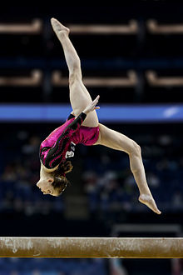

CLASSIFICATION OF motor SKILLS
This continuum is influenced by the impact
of the environment on the skill.
Closed Skills
Where the performer has the greatest control over their performance environment (weather, playing surface, opponent) and usually require repetition of a successful movement pattern
e.g. gymnastics
Open Skills
Where the performer is required to have flexibility and adaptation in the execution of a skill under a constantly changing environment or time pressure
e.g. kayaking
Closed skill
Predictability of the Environment
https://en.wikipedia.org/wiki/Somersault
Open skill
https://en.wikipedia.org/wiki/File:Kayak_Playboat_ManchesterNH.jpg
Home

Slide 12
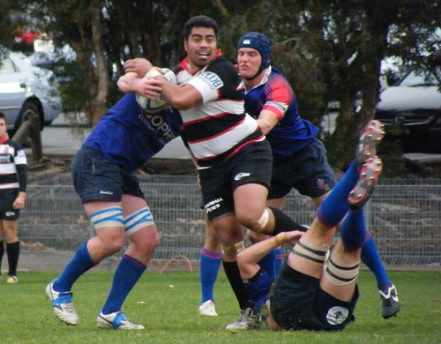
CLASSIFICATION OF motor SKILLS
Open Skills
Involve performing in an environment where critical information is constantly changing and the production of the skill must adapt to these changes
Performers use experience, perceptual skills and knowledge to analyse a given situation during the course of the performance before adapting a suitable skill in response
Decision making is made during the course of the performance
Games such as rugby, soccer, netball are open skills as the performer must take into account the movement of team mates and opposition when performing a skill
Performer must produce skills in a constantly changing environment.
Decision making must take into account a constantly changing environment.
www.flickr.com/photos/28990363@N05/3713746327/
Home

Slide 13
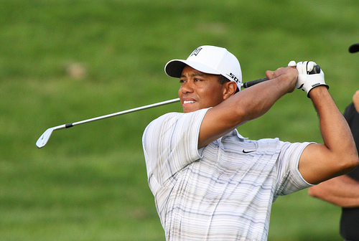
CLASSIFICATION OF motor SKILLS
Closed Skills
Take place in a stable, predictable environment which is self-paced
The skill is a pre–learned, rehearsed movement pattern, that the performer tries to reproduce the same way every time
The environment has little influence on the performer
e.g. diving, floor routine in gymnastics, shot putt
Golf is a closed skill as the environment is stable and does not change during the performance.
Decision making is done prior to performing the skill.
www.flickr.com/photos/keithallison/2311064240/
Home

Slide 14
CLASSIFICATION OF motor SKILLS
Typically occurs in dynamic (changing) environment
CLOSED SKILLS
Typically occurs in static (fixed) environment
OPEN SKILLS
Movements not affected by the environment and tend to be more habitual
Movements need to be continually adapted to meet the demands of the task
Skills are predominantly perceptual (adaptations can occur)
Skills are mostly externally paced (performer produces a skill at a time determined by an external source)
Has a defined beginning and ending
e.g. block in volleyball, pass in football, batting in cricket
e.g. shot in billiards, golf putt, free throw in basketball
Decision making made during the performance
Skills tend to be internally/self paced (performer determines when to start the skill)
Decision making made prior to performance
No defined beginning and ending
Involves a pre-learned pattern of movement
Home

Slide 15
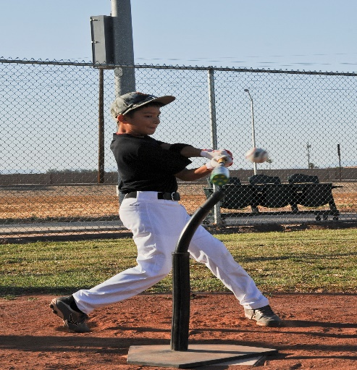
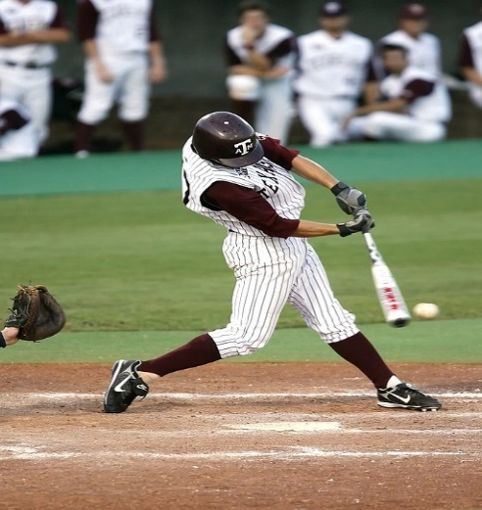
CLASSIFICATION OF motor SKILLS
Simple skill
This continuum is based on how difficult the
skill is to perform.
The difficulty or complexity of a task is affected by;
The number of relevant cues that require attention
The amount information that needs to be analysed
The number of available responses to select from
Time available to analyse information and select response
Task requirements – degree of speed and accuracy needed.
Complexity of the Task
https://en.wikipedia.org/wiki/Somersault
https://en.wikipedia.org/wiki/File:Kayak_Playboat_ManchesterNH.jpg
Complex skill
https://pixabay.com/photos/baseball-batter-hitting-sport-1606943/
Home

Slide 16
CLASSIFICATION OF motor SKILLS
Quickly learned, often by imitation of the demonstration
COMPLEX SKILLS
Require a longer learning and practice time
SIMPLE SKILLS
e.g. hitting a baseball off a tee
e.g. hitting a baseball that has been thrown by a pitcher
One cue only
No opposition players
Speed not important
Accuracy important
Many cues
Many available responses
Speed important
Accuracy important
Time pressure
No time pressure
Home

Slide 17
CLASSIFICATION OF motor SKILLS
Developing simple and complex skills in sport
Most sports require players to be able to produce simple and complex skills.
Players need to master simple skills before attempting complex skills e.g. a hockey player must be able to trap and pass before attempting the reverse tomahawk shot at goal.
Coaches need to develop a solid basic skills base and then develop the intermediate and advanced skills required for elite level performance. This is referred to as the skills hierarchy or skills pyramid.
Complex skills / strategies
Intermediate skills and strategies
Simple skills and strategies
Home

Slide 18
CLASSIFICATION OF motor SKILLS
Classification of Movement Skills
Predictability of the Environment
Open
Type of Movement
Movement Precision
Closed
Fine
Gross
Discrete
Continuous
Serial
Darts
Archery
Javelin
Weight lifting
Catching
Dance Routine
Running
Golf put
Hitting a Softball pitch
Returning a tennis serve
Home

Slide 19
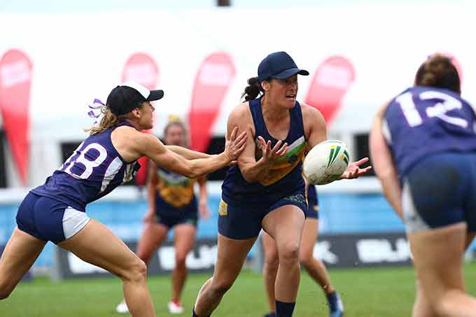
Fitts and posner PHASES of MOTOR learning
Fitts and Posner phases of motor learning and how they can be used to develop/improve specific physical skills
School Curriculum and Standards Authority. Physical Education Studies ATAR Year 11 Syllabus, 2016.
https://campaigns.health.gov.au/girlsmove/activity/touch-football-and-touch-rugby-league
Home

Slide 20
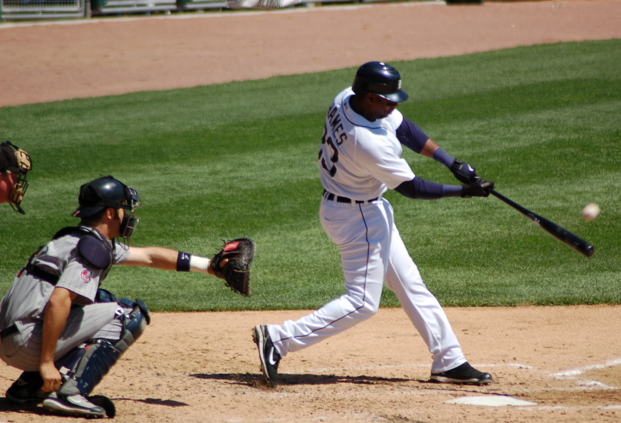
Fitts and posner PHASES of MOTOR learning
Fitts and Posner, 1967, proposed that motor learning is done in 3 progressive stages:
1. The Cognitive Phase
2. The Associative Stage
3. The Autonomous Stage
https://commons.wikimedia.org/wiki/File:Marcus_Thames_Tigers_2007.jpg
Home

Slide 21
Fitts and posner PHASES of MOTOR learning
The skill learning continuum
Cognitive Stage
What is to be done?
Associative Stage
Refine technique and perform basic skill
Autonomous Stage
Focus on strategy and tactics
Home

Slide 22
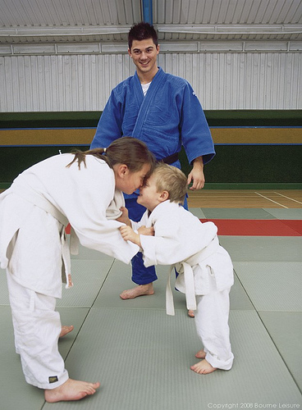
Fitts and posner PHASES of MOTOR learning
What is to be done?
First Stage of Learning: The Cognitive Phase
The initial phase in the learning of a motor skill where the emphasis is on conscious understanding of the task requirements.
Performer learns the nature and demands of the task
Performance level is inconsistent with frequent large errors – trial and error is common
Athletes more concerned with what to do rather than how to do it
Learner begins to develop the basic motor patterns for the task
Movements consciously controlled
Little, if any, cue recognition
Demonstration of the skill prior to performance and immediate feedback to correct errors is vital
All instructions, explanations and feedback must be kept simple
www.flickr.com/photos/23903805@N07/2284197118/
Time spent in this phase is relatively short as the performer will understand task requirements, aims of the game etc. quite quickly.
Home

Slide 23
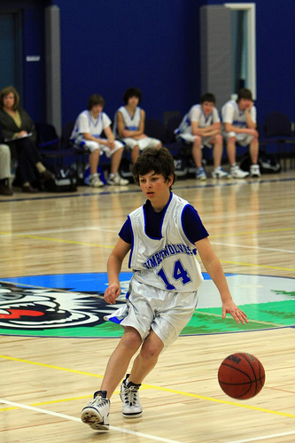
Fitts and posner PHASES of MOTOR learning
Refine technique
2nd Stage Of Learning – The Associative Stage
The second phase in the learning of a new skill in which movement patterns become more refined and consistent through practice.
Also referred to as the practice or intermediate stage
Characterised by plenty of practice to develop and
consolidate motor programs
Athlete associates environmental cues with actions
Parts of the skill become automatically controlled
Consistency improves
Size and frequency of errors decreases
External feedback is important but learner begins to understand and use internal feedback to change performance
Feedback contains more specific information
Selective attention improves
www.flickr.com/photos/juniorvelo/3259983044/
Home

Slide 24
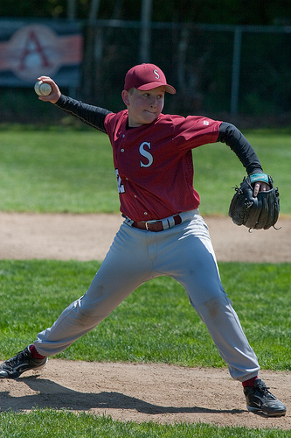
Fitts and posner PHASES of MOTOR learning
2nd Stage Of Learning – The Associative Stage (cont.)
The length of time in this phase varies depending on;
Task complexity
Level of ability
Amount of practice
Amount and quality of feedback
With practice;
Accuracy increases
Number of errors decrease
Size of errors decrease
Consistency improves
Cue recognition improves
Increased understanding of internal feedback
www.flickr.com/photos/chrisbrooks/3925653905/
Time in this phase can last from minutes to hours based on above points.
Some learners never move beyond this stage often due to a lack of motivation.
Home

Slide 25
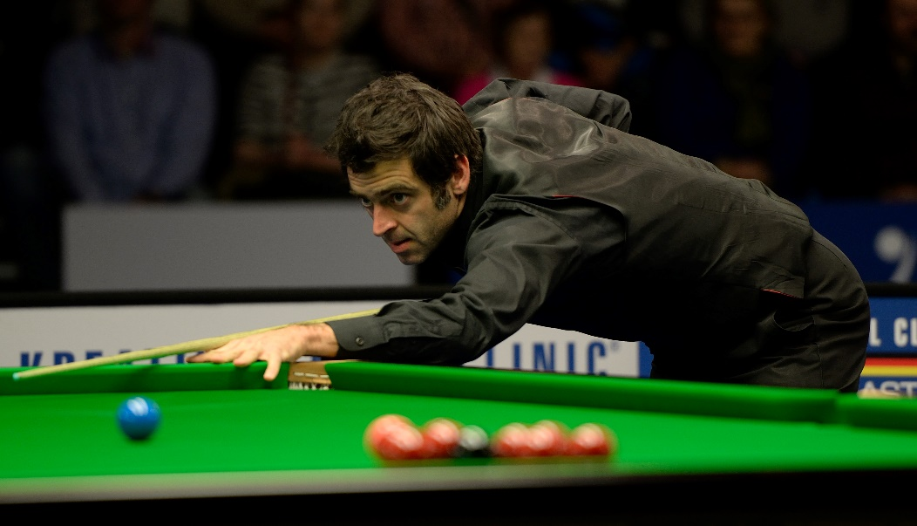
Fitts and posner PHASES of MOTOR learning
3rd Stage of Motor Learning – The Autonomous Stage
The final phase in the learning of a new skill in which the control of movement appears to be almost automatic and free of the need for constant attention.
Performer’s movements are fluent, well coordinated and seemingly effortless
Increased speed and accuracy of response to a given situation
Attends to relevant cues only – selective attention is high.
Little variability in day to day performance
Able to detect and self-correct errors
Skills are almost automated
Little attention given to technique allows more attention to be given to decision making and the application of tactics and strategies
Focus on strategy and tactics
Home
https://commons.wikimedia.org/wiki/File:Ronnie_O%E2%80%99Sullivan_at_Snooker_German_Masters_(DerHexer)_2015-02-05_02.jpg

Slide 26
Fitts and posner PHASES of MOTOR learning
 | Cognitive Phase | Associative Phase | Autonomous Phase
Error detection | Athlete has little capacity to detect or correct their own errors | Athlete begins to detect and correct their own errors | Athlete can detect their own errors and make adjustments accordingly
Feedback | Extrinsic augmented Simplistic and frequent feedback required | Combination of extrinsic augmented and intrinsic More specific feedback required | Mainly Intrinsic as athlete can self correct Very specific feedback when provided by extrinsic source
Cue recognition | Little, if no cue recognition | Some relevant cue recognition | Attends only to relevant cues with improved decision making
Consistency of performance | Very inconsistent from one attempt to the next | Consistency improves | Low performance variability
Size and frequency of errors | Large size and frequency of errors | Moderate size and frequency of errors | Very low size and frequency of errors
Type of performer | Novice | Intermediate | Expert
Home

Slide 27
The information processing model of learning
Phases of information processing during skill performance
identification of stimuli/input
response identification/decision making
response/output
feedback
School Curriculum and Standards Authority. Physical Education Studies ATAR Year 11 Syllabus, 2016.
Home

Slide 28
The information processing model of learning
The information processing model is based on the central nervous system that controls the body. This model describes separate cognitive stages involving perception, decision-making and response execution to enable a performer’s decision-making to occur prior to any action­.
www.flickr.com/photos/jimmyharris/116157552/
Home

Slide 29
The information processing model of learning
Information Processing Model of Learning
Information processing describes how performers;
Take in large amounts of information from the environment
Analyse and interpret the information
Make decisions about what response to make
The information processing model is a 4 stage process
1. INPUT
Information received by sensory system – mainly sight, sound, touch
2. PROCESSING
Information analysed, interpreted and response selected
3. OUTPUT
Selected movement is produced
4. FEEDBACK – Information about performance is received ⎯ can be internal / external or both
A simple Information Processing Model
Home

Slide 30
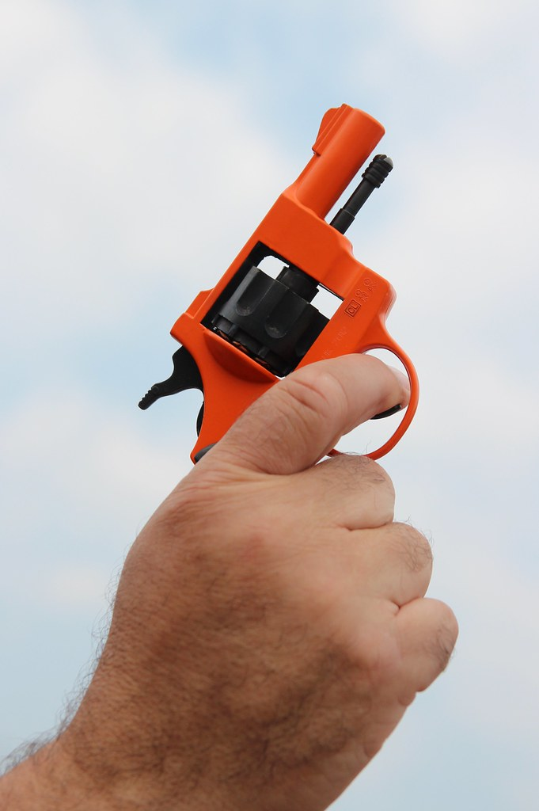
The information processing model of learning
STAGE 1: IDENTIFICATION OF STIMULI/INPUT
This stage involves the sensory mechanism detecting signals / cues in the environment (also known as the “display”).
Information is received from the environment via;
Sight
Sound
Touch
Proprioception
Equilibrium
The information is gathered from both internal and external sources.
Much of the information received is irrelevant to the performer and discarded.
High level performers are better at filtering irrelevant information
Relevant information is sent to the brain for further analysis and processing.
https://www.flickr.com/photos/comedynose/14499347799
Home

Slide 31
The information processing model of learning
STAGE 2: RESPONSE IDENTIFICATION/DECISION MAKING
The brain processes all the data received from the sensory system.
This stage involves 3 sequential processes;
Perceptual mechanism / stimulus detection
Decision making mechanism
Effector Mechanism /response selection
1. Perceptual Mechanism / Stimulus Detection
The perceptual mechanism analyses and interprets the data received from the sensory mechanism. This process is also known as stimulus detection and is influenced by the following;
The better the sense organs involved, the more likely it is that a cue will be detected.
Poor eyesight and hearing loss reduces the ability to detect cues.
Ability of the sense organs
Home

Slide 32
The information processing model of learning
The more intense a cue is, the more likely it is to be detected e.g. a loud bang from a starters gun is more likely to be detected than a quiet bang.
Making a cue stand out from the environment makes it easier to detect – this is the reason why sight screens are used in cricket.
Strength of the cue
In cricket a white ball against a black sight screen stands out more than a white ball against a white sight screen
Noise refers to any irrelevant cues in the environment which can distract a players attention away from the relevant cues.
Noise does not just refer to audible distractions but any distracting factors in the environment.
Noise
Home

Slide 33
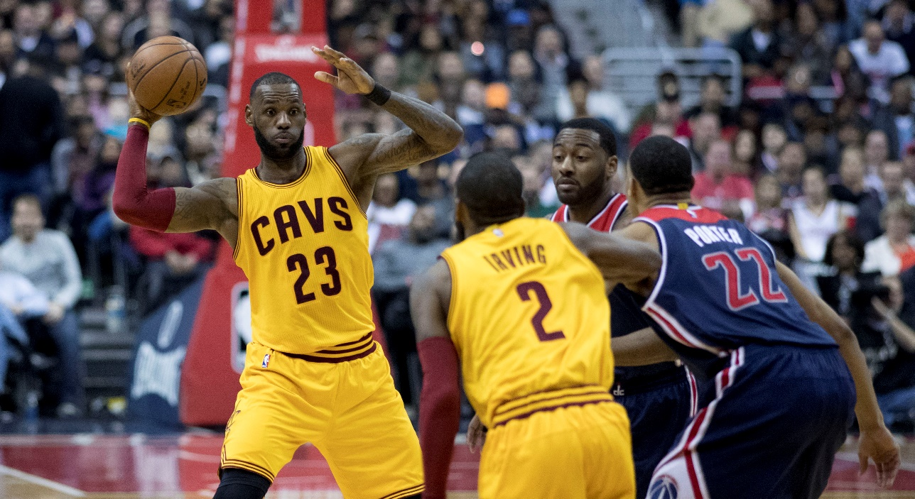
The information processing model of learning
The longer the cue is present in the environment, the more likely it is to be detected.
A fast bowler in cricket presents the cue (the ball) for only a short time to the batsman compared to a slow bowler.
An optimal arousal level is necessary if all relevant cues are to be detected.
An over aroused performer can imagine signals that are not present
An under aroused performer can miss cues which are present.
Length of the cue
Level of Arousal
Home
https://it.wikipedia.org/wiki/LeBron_James

Slide 34
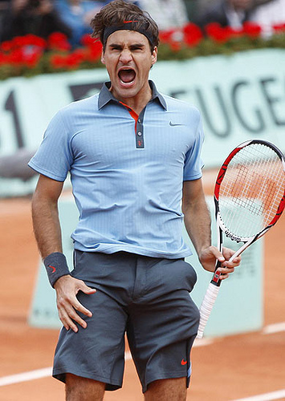
The information processing model of learning
A more experienced performer can detect and analyse more cues in a shorter period of time.
Experienced players have better selective attention and focus only on relevant cues.
Experience
The amount of information that can be taken in by inexperienced performers is low compared to more experienced players.
www.flickr.com/photos/39203725@N08/3598523111/
Home

Slide 35
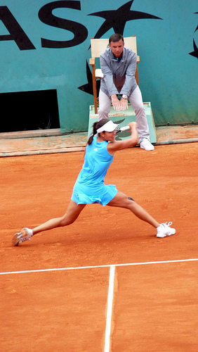
The information processing model of learning
Decision Making Mechanism
After all relevant data has been interpreted and analysed, the performer then makes a decision as to what response to make.
The response selected is influenced by past experiences, knowledge and skill level of the performer.
A skilful player has more responses to select from, and the decision making process takes longer as the number of responses increases.
What responses were available to Ana Ivanovic as she prepared to return the ball?
Lob?
Drop shot?
Play down the line?
Play across court?
Top spin?
Back spin?
www.flickr.com/photos/la_bretagne_a_paris/3576347251/in/set-72157619383245640/
Home

Slide 36
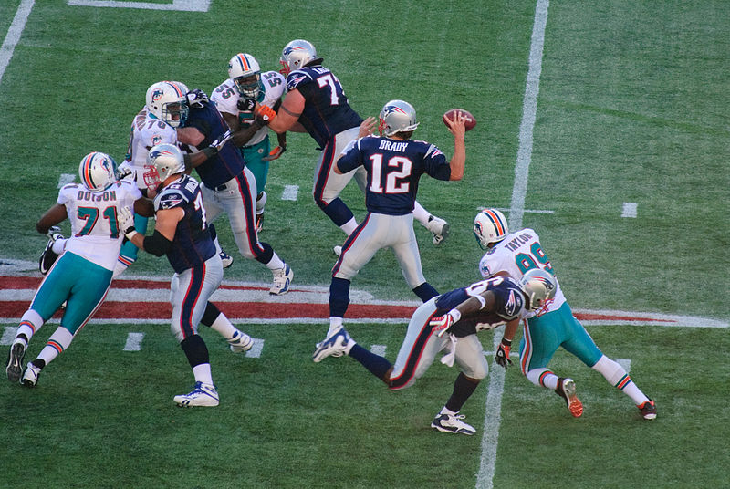
The information processing model of learning
Hicks Law states the greater number of possibilities available to a performer, the longer it takes for them to react.
1 choice = fast reaction time
2 choices = slower reaction time
3 choices = slightly slower reaction time than 2 choices
4 choices = slightly slower reaction time than 3 choices
The more choices a person has, the more information that needs processing and the longer it takes to process, resulting in a slower reaction time
https://fr.wikipedia.org/wiki/Fichier:Tom_Brady_and_the_Miami_Dolphins.jpg
Home

Slide 37
The information processing model of learning
Hicks Law showing how reaction time increases with increasing number of stimuli
Reaction time
Number of alternative stimuli
Home

Slide 38
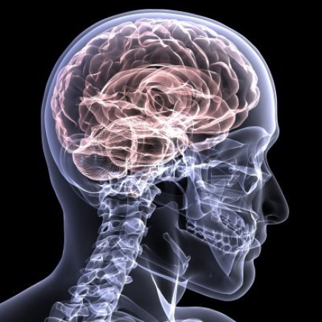
The information processing model of learning
Effector Mechanism /response selection
The effector mechanism and central nervous system prepare to produce the response selected as a result of the decision making process. The requisite motor program is retrieved from long term memory.
Messages are sent via the neuromuscular system to the muscles and nerves which then create the specific movements required to produce the selected response.
https://www.army.mil/article/142825/traumatic_brain_injury_awareness_month_highlights_resources
Home

Slide 39
The information processing model of learning
STAGE 3 – RESPONSE/OUTPUT
This stage involves the neuromuscular system producing the movements required to produce the selected response.
The selected response is chosen by the individual and the muscles are prepared to perform the task
The complexity of the task determines the amount of time required for response programming
Simple skills have very fast response programming
Complex skills have more information to process and therefore the response of the muscles is much slower
This stage is the production of the action selected by the decision making process and is the “movement time” component of the total response time.
Home

Slide 40
The information processing model of learning
Response time ⎯ the time taken from the presentation of a stimulus to the completion of the movement
Reaction time ⎯ the time between the presentation of a stimulus and the initiation of the response. It is the time the information processing system takes to interpret the situation, formulate a motor program and transmit the information to the Muscular System.
Movement time ⎯ the time taken from the initiation of the movement to the completion of the movement. It is the time the performer takes to physically complete the movement when the muscular system has received the message from the brain via the effector system.
Home

Slide 41
The information processing model of learning
Relationship between:
Reaction Time
Movement time
Response time
Reaction Time
Movement Time
Cue / Stimulus
Initiation of response
Completion of response
Response Time
Home

Slide 42

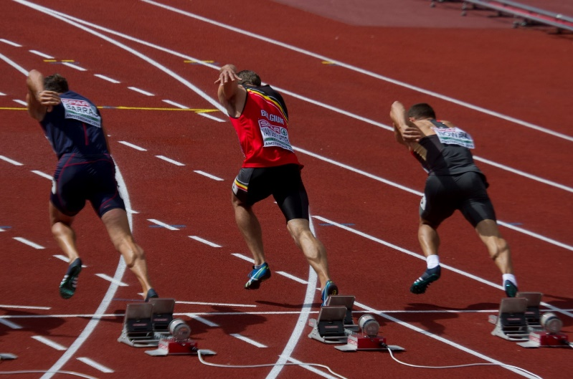
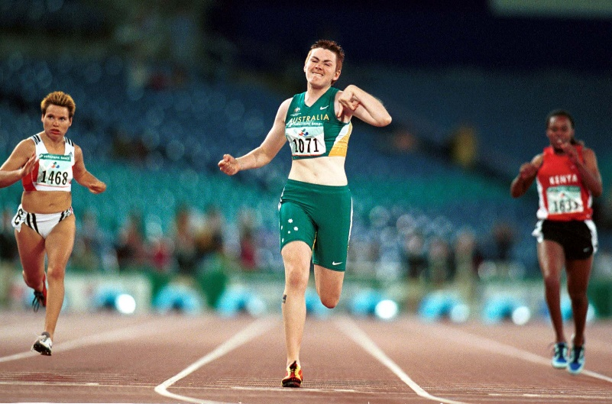
The information processing model of learning
https://commons.wikimedia.org/wiki/File:0011_start_100m_vdp_(27923890674).jpg
https://commons.wikimedia.org/wiki/File:301000_-_Athletics_track_100m_Lisa_McIntosh_action_-_3b_-_2000_Sydney_race_photo.jpg
Reaction Time
Movement Time
Response Time
Home

Slide 43
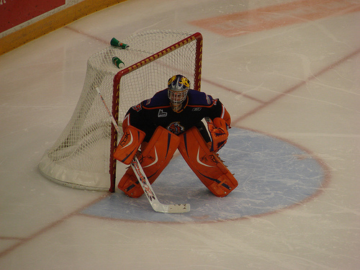
The information processing model of learning
The importance of response time varies from sport to sport – in some sports such as golf, it is of little importance but in others it’s critical to a successful outcome.
Ice Hockey
Reaction Time: Time between detecting the cue (the puck) and initiating a movement in response.
Movement Time: Time taken from initiating movement until the movement is complete
Response Time: If the response time is too slow, the puck will be in the back of the net before the response is complete.
www.flickr.com/photos/greghickman/1663989552/in/set-72157618281695993/
Home

Slide 44
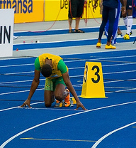
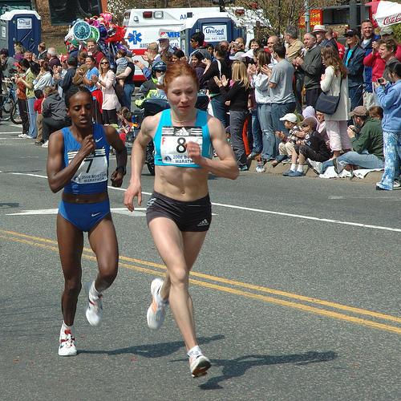
The information processing model of learning
Athletics - sprints
Reaction time critical to outcome of the event.
At the elite level, the ability to “get out of the blocks” is essential to good performance.
http://www.flickr.com/photos/az1172/3840351933/
Athletics middle / long distance
Reaction time is much less important given the total time of the event e.g. reaction time is of no importance time at the start of a marathon.
The shorter the run, the greater the importance of reaction time.
www.flickr.com/photos/kevino/2433187308/
Home

Slide 45
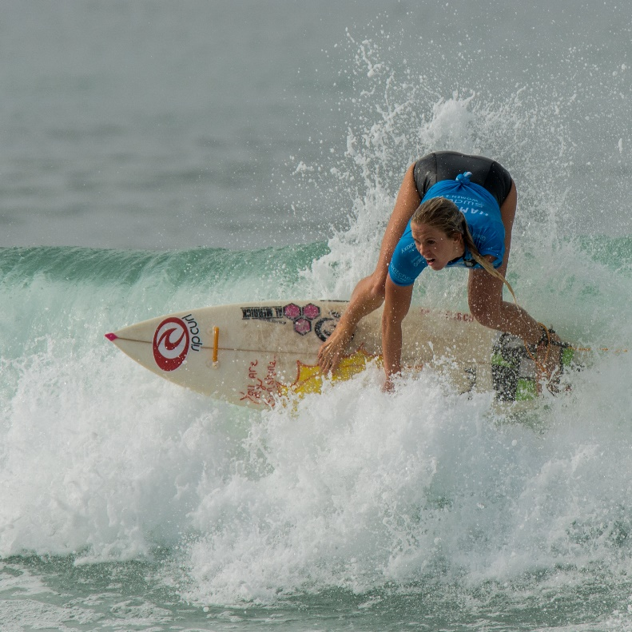
The information processing model of learning
STAGE 4: FEEDBACK
The athlete receives feedback about the performance of the selected response.
The feedback can be internal, external intrinsic or external augmented.
Feedback provided during the performance (concurrent) can be used to help achieve the goal of the task immediately
A surfer who feels themselves over balancing uses proprioceptive feedback to readjust their body position and maintain their balance
Feedback provided after the performance (terminal) is typically extrinsic augmented and provides information about either the quality of the performance (qualitative) or result (quantitative) of the movement
The athlete and coach might compare their just completed performance against the desired performance and use the information to improve deficient parts of their technique for future attempts.
https://commons.wikimedia.org/wiki/File:Bethany_Hamilton_surfing_(sq_cropped).jpg
Home

Slide 46
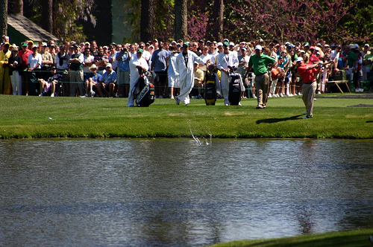
The information processing model of learning
STAGE 4: FEEDBACK
Discuss the 4 stages of the information processing model as it relates to golf.
www.flickr.com/photos/gomattolson/124752983/
Home

Slide 47
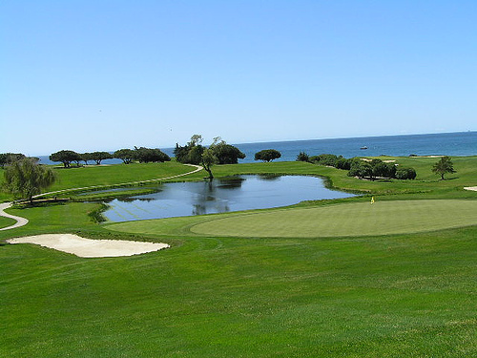
The information processing model of learning
Example of the Information Processing Model in Golf;
Stage 1 - The Sensory Mechanism
Gathers information from the environment
and sends it to the brain.
Stage 2 - Perceptual Mechanism
Examines the environment;
Wind speed and direction
Slopes
Position of bunkers
Other contributing factors
The perceptual mechanism will also later interpret;
Knowledge of results
Knowledge of performance
www.flickr.com/photos/golf_pictures/168838012/
Bunkers
Wind
Sloping green
Water hazard
Analysed by perceptual mechanism
Home

Slide 48
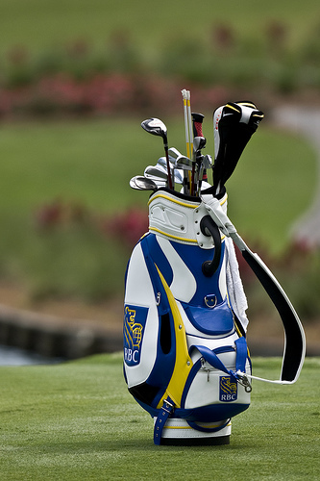
The information processing model of learning
Stage 2 - The Decision Making Mechanism
The decision mechanism determines;
Which club to use
What type of shot to play
Where to hit the ball
This decision making is influenced by past experiences and skill level e.g. a golfer has knowledge of how far each club hits the ball.
Golfer would consider the likelihood of success and risks associated with each available response.
The more past experiences a player has, the more likely they are to make the correct decisions.
www.flickr.com/photos/nsaplayer/3542653346/
Home

Slide 49
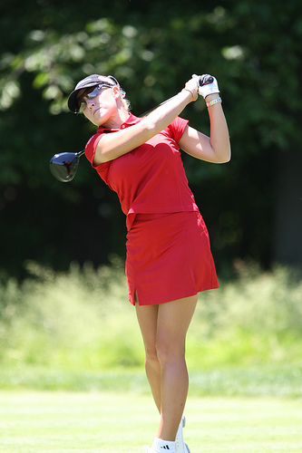
The information processing model of learning
Stage 2. The Effector Mechanism
The performer will have many motor programs available to allow the successful execution of the selected response.
The motor programs selected is based on the requirements of the shot e.g. putt vs. drive.
The effector mechanism will control all aspects of the shot;
Grip
Stance
Backswing
Forward swing
Follow through
The more experienced the player, the greater the number of available motor programs and the greater the number of available responses.
www.flickr.com/photos/keithallison/2546266653/in/set-72157605406506727/
Home

Slide 50
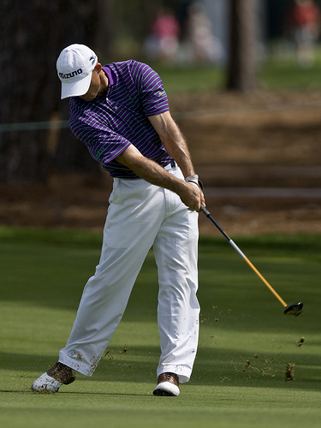
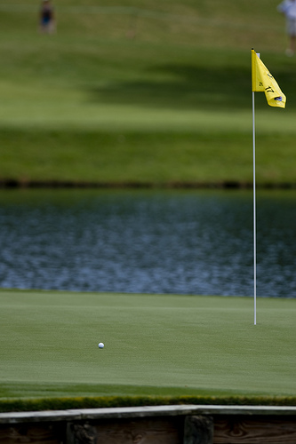
The information processing model of learning
Stage 3 – Output
The selected response is produced by the muscles.
The stroke is made.
www.flickr.com/photos/nsaplayer/3540540235/in/set-72157618389573288/
Stage 4 – Feedback
The player receives feedback about the performance.
This would include knowledge of results (where the ball finished up) and knowledge of performance (how the skill felt as it was executed)
www.flickr.com/photos/nsaplayer/3541896483/in/set-72157618412280072/
Home

Slide 51
The information processing model of learning
Stage 1 - Input
Information received by sensory system – mainly sight, sound, touch, smell
Stage 2 – Decision making
Perceptual mechanism | Decision making mechanism | Effector mechanism
Analyses and interprets the data received from the sensory mechanism. | Based on info provided from perceptual mechanism, decision is made on which response to make | Organises, initiates and controls chosen motor program
Stage 4 - Feedback
Information about performance is received - can be internal / external or both
Stage 3 - Output
Selected movement is produced
Home

Slide 52
TYPES OF CUES
Types of cues used to improve performance
visual
verbal
proprioceptive
School Curriculum and Standards Authority. Physical Education Studies ATAR Year 11 Syllabus, 2016.
Home

Slide 53
TYPES OF CUES
To maximise performance, a performer needs to be able to interpret and understand internal and external cues.
The use of cues starts in the cognitive stage of learning and continues throughout the journey of any athlete.
The use of demonstrations, instructions and practice all provide opportunities for learners to start to recognise cues and respond appropriately
Three main types of cues are;
Visual
Verbal
Proprioceptive
Types of Cues Used To Improve Performance
Home

Slide 54

TYPES OF CUES
Give the learner an opportunity to watch the desired skill or use visual aids as targets
Often provided as a demonstration. This is the most effective method of introducing a performer to a new skill and is critical in the cognitive stage of learning.
During a demonstration learners are shown how to perform the skill with 3 or 4 key points verbalised.
Visual cues are provided as an external cue and can be used for athletes in all stages of learning
1. Visual Cues
https://pixnio.com/sport/archery-contest-and-demonstration
Home

Slide 55
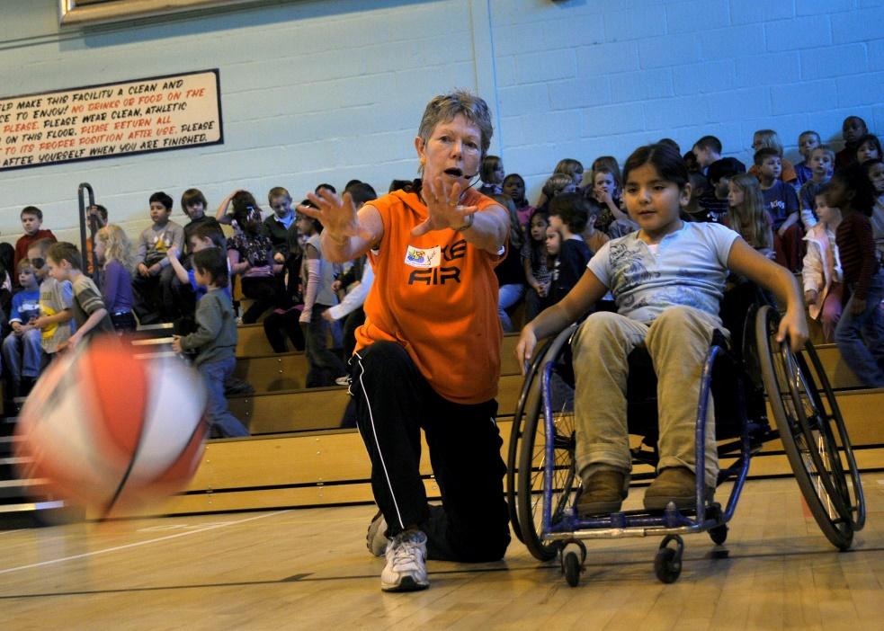
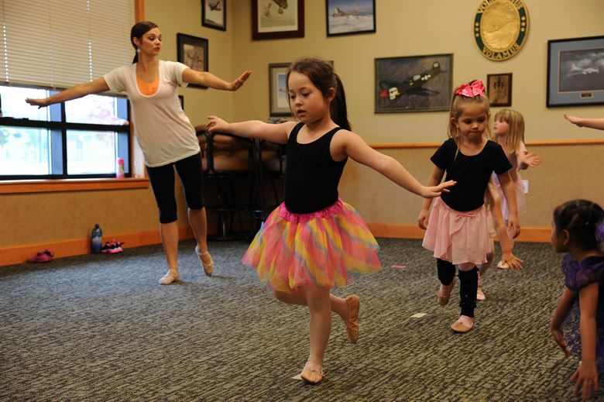
TYPES OF CUES
Cognitive performers using visual cues to improve performance;
A demonstration is a great way to provide beginners with a visual representation of how the skill looks. It is important to accompany it with a maximum 3 - 4 key teaching points so not to distract the learner.
https://www.lakenheath.af.mil/News/Photos/igphoto/2000442988/
A dance instructor might provide visual cues in the way of markings on the ground for the learners to practice feet positioning and sequencing of steps.
https://www.malmstrom.af.mil/News/Article-Display/Article/824970/dance-like-no-one-is-watching/
Home

Slide 56
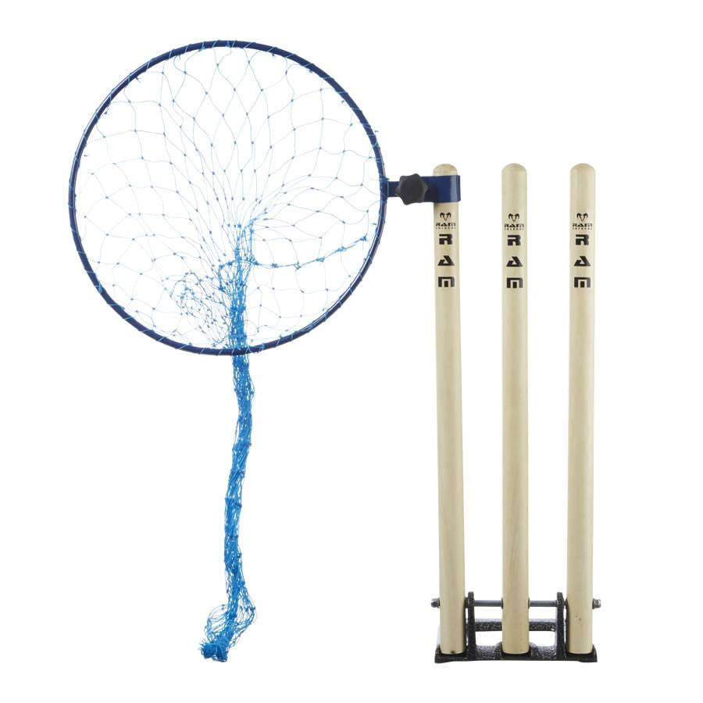
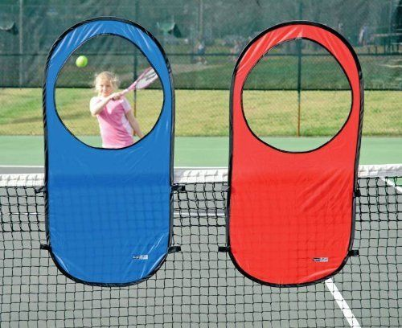
TYPES OF CUES
Associative performers using visual cues to improve performance;
Coaches might use visual aids to encourage players to aim for them, enhancing performance.
https://www.ramcricket.co.uk/products/metal-bowling-target
Targets can also be used to improve accuracy and increase enjoyment.
https://www.pinterest.com.au/pin/127226758202369085/
Home

Slide 57
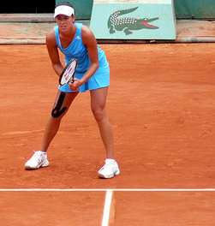
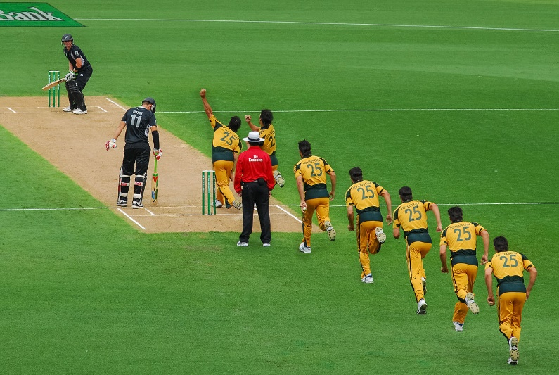
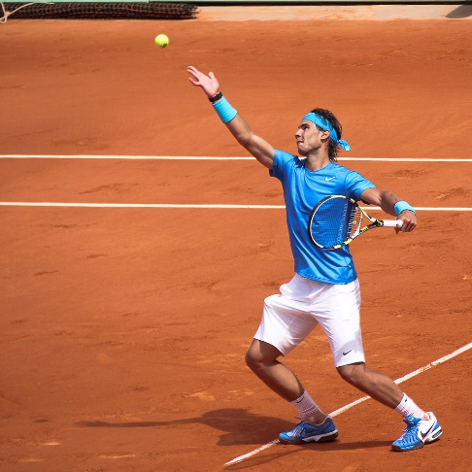
TYPES OF CUES
Autonomous performers using visual cues to improve performance;
The server would see that Ana Ivanovic is standing very wide on the service court and has left a big gap down the centre of the court.
https://www.flickr.com/photos/la_bretagne_a_paris/2548329975
Batsmen observe the grip the bowler has on the ball and where the shiny side of the ball is located to work out what sort of delivery the bowler is attempting to deliver.
https://commons.wikimedia.org/wiki/File:Run-Up_study_of_Mitchell_Johnson_100311_1.jpg
Some players analyse the stance, grip, service position and ball toss of their opponent to try and determine what type of serve is being attempted.
Home
https://www.flickr.com/photos/la_bretagne_a_paris/5756505698

Slide 58
TYPES OF CUES
A short task oriented phrase which directs a performers attention to task relevant stimuli in order to enhance performance
Instruction and feedback provide information to the performer about what is being done correctly and incorrectly.
Verbal cues can increase in complexity and specificity as the performer becomes more experienced.
Coaches and players can use verbal cues immediately prior to performance to focus on key points.
E.g. a young footballer might say the words ‘through the ball’ to focus their movements when kicking
Positive verbal cues can motivate performers.
2. Verbal Cues
Home

Slide 59

TYPES OF CUES
Proprioception is internal feedback which comes from sensory receptors – called “proprioceptors” ⎯ found in joints, tendons and muscles.
Proprioceptors send information to the central nervous system detailing position, posture, equilibrium, and internal conditions of the body.
Equilibrium relates to the balance and positioning of the body. A performer uses this information to detect and correct errors and to adjust their body position if required
e.g. a gymnast on a balance beam can feel a loss of balance and re-distributes her body weight to correct the error.
Proprioceptive cues help the central nervous system to control the force, speed and position of the body. Players can use this information to change their next performance if required.
3. Proprioceptive Cues
Surfing requires the performer to change their body position to maintain balance during the ride. This information comes from proprioceptors.
Home
https://www.flickr.com/photos/blachswan/33888138506

Slide 60
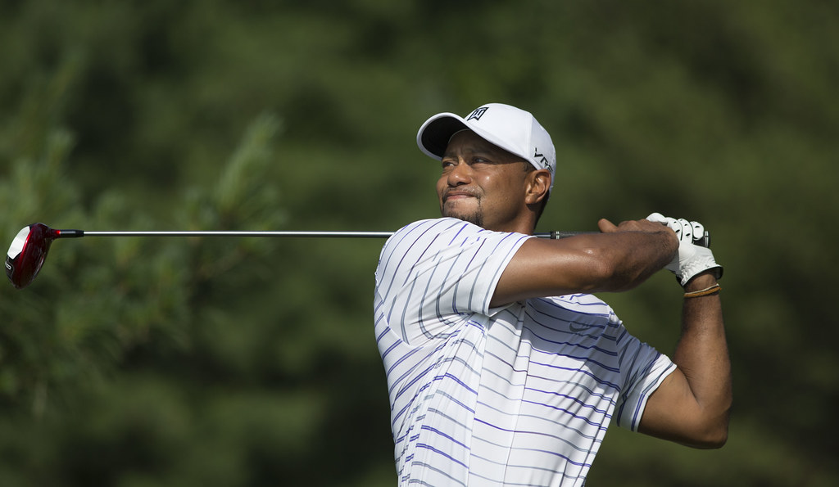
TYPES OF CUES
Is information from within the body about how the movement felt and can be used by experienced performers to change their next performance
e.g. a golfer who can feel her wrists rolling open during the downswing resulting in a sliced shot will make changes to the next shot.
Kinaesthetic awareness develops with practice and increasing experience. It increases the ability of the performer to self-detect errors about how the movement felt and make corrections to improve subsequent performances.
Kinaesthetic information
Elite performers can “feel” how well the movement was performed.
Home
https://www.flickr.com/photos/keithallison/14319792669

Slide 61
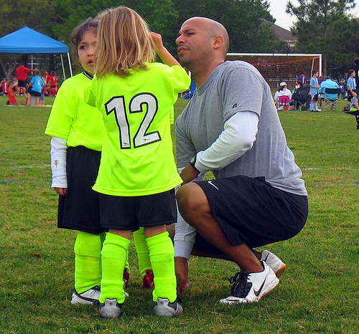
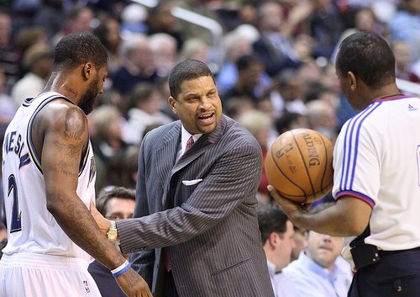
feedback
Purpose of feedback
Reinforcement
Motivation
Types of feedback
Intrinsic (inherent)
Extrinsic (augmented) – terminal, concurrent, verbal, non verbal
School Curriculum and Standards Authority. Physical Education Studies ATAR Year 11 Syllabus, 2016.
www.flickr.com/photos/22863752@N06/2366345767/
www.flickr.com/photos/keithallison/2310504297/in/set-72157604374114541/
Home

Slide 62
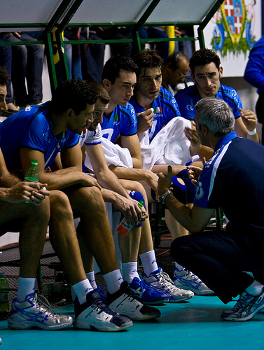
feedback
Feedback
Feedback is the information a performer receives about their performance of a skill. It can be given prior to, during, or after performance.
Feedback is essential to improvement as it allows the performer to compare their current performance with desired performance.
Without feedback, a performer will not be able to correct errors and make changes to improve performance with the same speed and proficiency as when feedback is available.
www.flickr.com/photos/apesara/2507368305/
Home

Slide 63
PURPOSE OF feedback
Purpose of feedback
A coach can provide feedback which motivates the performer to continue to strive for improvement or to re-assure the performer that progress is happening
Motivational feedback must be realistic and has been known to have the following impact on performers
They are more interested and involved in training
Persist longer in learning a skill
Apply greater effort to learning a skill
1. To motivate the performer
“You are currently at stage 11.4 in the Beep Test. If you can get to stage 13.5, you will be considered to play in the starting line up.”
Home

Slide 64
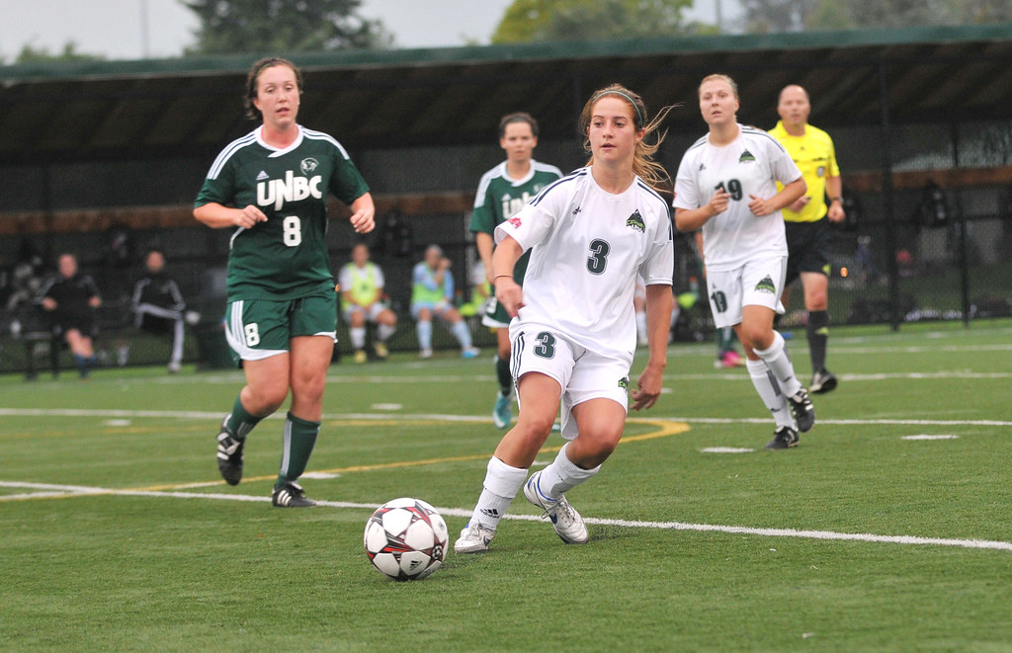
PURPOSE OF feedback
Feedback can be used to reinforce learning or performance which increases the chances of the behaviour being repeated.
This is particularly important for individuals in the Cognitive stage of learning as they begin to understand the demands of the task
Positive feedback should be included in the feedback as should some words of encouragement to maintain motivation levels.
2. To reinforce learning and provide information
“You played really well today because you looked for a team mate to pass the ball to, just like at training, instead of just kicking it without looking first. Really good effort – well done.”
https://www.flickr.com/photos/ufv/9906275783/
Home

Slide 65
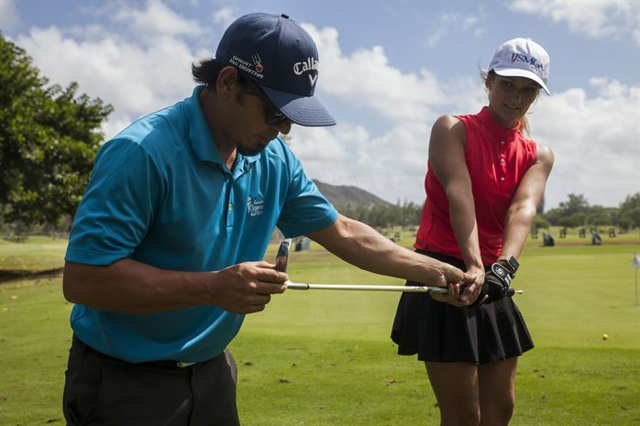
PURPOSE OF feedback
Feedback can also be given to the performer aimed at changing aspects of their performance.
By providing information about what was performed correctly and incorrectly during the previous performance, the athlete can make the necessary changes to improve their next attempt
Feedback is often provided using video analysis
2. To reinforce learning and provide information
Home
https://www.mcbhawaii.marines.mil/Photos/igphoto/2001832435/

Slide 66
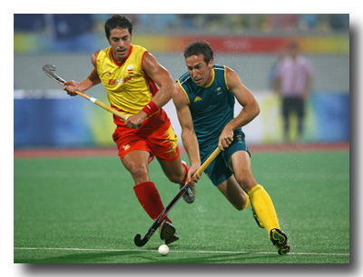

Types of feedback
Feedback
Types of feedback
Intrinsic (inherent)
Extrinsic (augmented)
www.flickr.com/photos/31775761@N08/3079332272/
www.flickr.com/photos/chrisamichaels/3230953200/
Intrinsic (inherent) feedback is received from sensory receptors inside muscles, joints and tendons which provide information to the performer about their execution of the skill.
Internal feedback allows a player to know how well the ball was hit as soon as contact between ball and stick is made.
Extrinsic (augmented) feedback is information received from outside the body.
It is received by the sensory system and is seen, felt or heard and is delivered by a coach or instructor.
Provides additional information to the performer e.g. coach tells the player they missed the shot at goal because they had no follow through
Home

Slide 67



Types of feedback
Types of feedback
External Feedback cont.
Extrinsic Feedback can be further categorised as either:
Knowledge of Results
Knowledge of Performance
Subjective feedback that a performer receives regarding the quality of their movement or technique
Analysis of technique and execution of the performance
Objective feedback which provides the performer with information regarding the success of their performance in achieving a desired outcome
Analysis of the result or outcome of the movement
Feedback
Intrinsic
Extrinsic
Knowledge of Performance
Knowledge of Results
Knowledge of Performance
Basketball – “you are getting good knee bend on your free throws”
Knowledge of Results
www.flickr.com/photos/keithallison/3996909163/
Knowledge of Results
Home
www.flickr.com/photos/cobaltfish/2712546351/

Slide 68

TIMING of feedback
Timing of extrinsic feedback
Extrinsic (augmented) feedback can be provided either during the performance e.g. a runner taking a message to a player, at half-time or other break in play. It can also be provided after the performance has been completed.
Provided during the performance via the coach.
The player can use this information to immediately change performance if need be, or if the feedback is positive, maintain current performance.
E.g. a soccer coach who provides verbal feedback to their defensive line during a game to immediately change their position
Concurrent Extrinsic Feedback
Concurrent feedback can be used to change immediate performance.
Home
https://www.afimsc.af.mil/News/Article-Display/Article/754429/as-armed-forces-soccer-tournament-nears-air-force-team-kicks-into-high-gear/

Slide 69

TIMING of feedback
Timing of extrinsic feedback
Provided by an external source after the movement has been completed
The performer can only use this feedback to change future performance.
The individuals stage of learning dictates how long after the performance the feedback should be provided
Cognitive – the sooner the better as novice performers will find it harder to reflect on their performance after a period of time
Autonomous – whilst immediate terminal feedback is effective, it may also be beneficial to allow the performer to think about and evaluate their own performance before providing feedback.
Terminal Extrinsic Feedback
https://commons.wikimedia.org/wiki/File:Working_as_a_coach_in_dressing_room.JPG
Home

Slide 70


Frequency of feedback
Frequency of extrinsic feedback
No set rule regarding how often a coach should provide feedback during a skills session
Generally accepted that the frequency should be reduced as a performer moves through the stages of learning from Cognitive to Associative (and possibly to Autonomous as not all performers move through to this stage)
Cognitive
Associative
Autonomous
www.flickr.com/photos/barretthall/4002931368/
www.flickr.com/photos/apesara/2507368305/
Feedback Frequency
www.flickr.com/photos/kikisdad/sets/72157604951748156/
Frequently during each skills session
Less frequently
Infrequently
(coach instead focuses on game tactics)
Home

Slide 71

Types of feedback
Non-verbal Extrinsic Feedback
Non-verbal feedback is feedback communicated to the performer without using words. Gestures, body language, posture, facial expression, hand signals can all convey information to a performer.
Non-verbal feedback is often used in conjunction with verbal feedback and can, if used correctly, reinforce the verbal communication e.g. a coach with an angry facial expression giving the team a spray at half time about their poor first half performance has his verbal message reinforced by his facial expression.
A volleyballer uses hand signals as a form of non-verbal feedback
www.flickr.com/photos/keithallison/2310504297/in/set-72157604374114541/
The coach’s facial expression is a form of non-verbal feedback. He’s not happy!
www.flickr.com/photos/cmaccubbin/2796379630/in/set-72157606950158109/
Home

Slide 72

Types of feedback
Non-verbal Extrinsic Feedback (cont.)
Technological advancements have also allowed coaches to provide non verbal feedback easily and efficiently
Video feedback allows players to see themselves performing a given skill and compare with either past performances or an expert
This is most effective when used in conjunction with verbal feedback, as the coach is able to direct the learner to key points of their performance
Physiological feedback through the use of Heart rate monitors and GPS trackers also allow coaches to provide non-verbal feedback to athletes easily.
Athletes are able to see if they are performing at the correct intensity and completing the desired movement patterns
https://www.flickr.com/photos/chrishunkeler/8722599184
Home

Slide 73

Types of feedback
Verbal Extrinsic Feedback
This is spoken augmented feedback provided by a coach or similar
Coaching guidelines suggest verbal feedback should take on the following characteristics
Be specific, not general
Be constructive, not destructive
Be directed at behaviour which is changeable
Be clear and concise
E.g. a baseball catcher may say to the pitcher – “your rushing your pitches today and you look off balance when you release the ball – slow down and try and get some rhythm into your throws”.
https://www.needpix.com/photo/980780/baseball-catcher-player-ball-equipment-american-game-sport-uniform
Home

Slide 74
CHARACTERISTICS of EFFECTIVE feedback
Characteristics of effective feedback
General
“Good work. Well done”
Contains no information that the performer can use to improve / change future
performance.
Specific
Contains information
“You played well today – your catching in the outfield was excellent because you moved
into the correct position under the ball much quicker than last week”
Specific, not general
Coaches often use both general and specific feedback with their players – “Much better second quarter Sally, your working much harder. Now I want you to play a negating role on their number 7 making sure you keep goal side of her at all times”.
Home

Slide 75
CHARACTERISTICS of EFFECTIVE feedback
Constructive recognises positive parts of the athletes behaviour and suggests further ways to improve. Destructive provides no motivation or encouragement.
Constructive
“An improved defensive effort today but you must work to make yourself an option in
attack”
Destructive
“Did you catch a train to the ground? You are a passenger today – just terrible!”
Constructive, not destructive
Home

Slide 76

CHARACTERISTICS of EFFECTIVE feedback
Changeable:
“Move your feet into position sooner”
Unchangeable:
” You’re too short to play in first team”
Feedback should be easily understood and relate specifically to the situation at hand.
Feedback should contain one or two points only to avoid overloading the performer.
If feedback is unclear, the performer may become confused about the situation and
make errors.
Directed at behaviour which is changeable
Clear and concise
www.flickr.com/photos/cmaccubbin/2820063211/in/set-72157606950158109/
Home

Slide 77
FACTORS AFFECTING SKILL ACQUISITION
Relationship between skill learning processes and individual differences related to
age
skill and fitness level
injury
level of competition
type of activity
School Curriculum and Standards Authority. Physical Education Studies ATAR Year 11 Syllabus, 2016.
Home

Slide 78
FACTORS AFFECTING SKILL ACQUISITION
Not all performers learn at the same speed or reach the same degree of expertise – many do not reach the autonomous but others reach elite levels and represent Australia.
3 key factors which affect motor learning;
Individual differences which relate to the characteristics of the learner.
Task factors which relate to the complexity and demands of the task.
The learning environment which is affected by the quality of coaching, practice and feedback provided to the learner
Home

Slide 79

FACTORS AFFECTING SKILL ACQUISITION
Individual differences account for the variation in learning and perfecting skills.
Factors affecting learning include;
Age
Skill level
Level of physical fitness
Injury
Level of competition
Type of activity
http://www.dodlive.mil/2016/02/04/how-army-research-is-combating-concussions-in-the-nfl/
Home

Slide 80


FACTORS AFFECTING SKILL ACQUISITION
Age
The ability of a learner to take in and process information increases as they get older along with their ability to practice for longer. Coaches need to be aware of the physical characteristics of the learners they are working with.
Children grow at different rates and those who mature earlier can perform at a higher level than less mature peers as they are bigger and stronger.
Elderly participants need to be careful to avoid problems associated with the degenerative aging process e.g. brittle bones, decreased physiological capacities.
https://pixabay.com/photos/young-children-male-sport-soccer-1280663/
https://en.wikipedia.org/wiki/File:Oleg_Starinskyi_coaching_kids_during_AC_Milan_junior_camp_in_Kyiv.jpg
Home

Slide 81
FACTORS AFFECTING SKILL ACQUISITION
1. Age (cont.)
When coaching children, there should be a focus on the following;
Delivering enjoyable and engaging sessions
Maximising participation through low ball:student ratios
Developing interpersonal skills
Coaches must be aware of the physiological and psychological limitations children poses and cater for this through reduced sessions times, increased variation in drills and activities, increased breaks for drinks etc.
In coaching older people and veterans, there should be a focus on the following;
Increased warm ups and cool downs due to reduced physical capabilities
Strict screening prior to engaging in a physical activity program
Appropriate footwear and other protective clothing
Careful application of progressive overload principle
Home

Slide 82

FACTORS AFFECTING SKILL ACQUISITION
2. Skill Level
The coach needs to consider the current skill level of individual athletes in the squad before structuring their training program.
A coach who plans training sessions which are too complex or too simple will not achieve the optimum level of skill development with the group e.g. the coach of an F grade team would not plan a training session which is more suitable to an A grade team as the players do not have the requisite skills.
https://www.google.com/search?client=firefox-b-d&biw=1440&bih=724&tbs=sur%3Afc&tbm=isch&sa=1&ei=XXEkXf_zPIzcrQGY1pL4Dw&q=junior+sport+training&oq=junior+sport+training&gs_l=img.3...48089.49616..49814...0.0..0.160.1378.0j9......0....1..gws-wiz-img.......0i30j0i5i30j0i8i30.60YPwADEfY8#imgrc=kn1baVpEZNT2hM:
Home

Slide 83
FACTORS AFFECTING SKILL ACQUISITION
2. Skill level (cont.)
The coach/teacher must understand the Stages of Learning (described earlier in this ppt) and the impact it has on skill learning. This will help guide;
The frequency and type of feedback provided to the learner
The type of cues used
The style of leadership/coaching provided
The complexity of drills used
In general, learners in the cognitive stage require more frequent feedback delivered from the coach. The use of visual cues such as demonstrations and targets are also vital to development
More advanced performers can rely on less frequent feedback as they are able to self correct (and should be encouraged to do so). Feedback needs to be very specific and complex drills which encourage problem solving should be provided.
Home

Slide 84

FACTORS AFFECTING SKILL ACQUISITION
3. Level of Physical Fitness
Fitter performers are able to practice for longer and at a higher level than less fit performers. This increases their skill learning capability.
As learners fatigue, their level of performance deteriorates. A fitter learner can practice for longer which improves their skill level and decreases the size and frequency of their errors.
Fit athletes are able to train for long periods at high intensity and therefore will develop skills faster.
https://www.armyupress.army.mil/Journals/NCO-Journal/Archives/2018/October/Tailored-Fitness-Programs/
Home

Slide 85

FACTORS AFFECTING SKILL ACQUISITION
3. Level of Physical Fitness (cont.)
Coaches must adjust the intensity, frequency and duration of sessions to cater for the varying fitness levels of individuals
Initial testing can be used to help determine the starting point for athletes
Whilst it is important to develop the physiological capacity of learners, it must also be understood that athletes concentration deteriorates with fatigue.
As a result coaches should ensure new skills /activities are delivered whilst players are fresh and not suffering fatigue.
https://www.pexels.com/photo/soccer-kids-training-890562/
Home

Slide 86

FACTORS AFFECTING SKILL ACQUISITION
4. Injury
Injured athletes need to modify their training program or risk further damage to the injured area.
This may affect the performer’s skill development especially if the injury requires long term rehabilitation e.g. osteitis pubis which can take months to rehabilitate.
https://pixabay.com/photos/football-usa-sport-sports-tackle-102670/
Home

Slide 87

FACTORS AFFECTING SKILL ACQUISITION
4. Injury (cont.)
It is important coaches understand the use of training principles and recovery methods in order to prevent injury to their athletes
These days it is common to make injured players sit with the coaches to gain a better perspective and develop game knowledge
https://commons.wikimedia.org/wiki/File:Karyn_Marshall_Ice_Bath.jpg
Home

Slide 88

FACTORS AFFECTING SKILL ACQUISITION
5. Level of competition
One of the most important roles of a coach is to ensure their style of leadership meets the needs of their players. Part of this involves an understanding of their motivation to participate.
For individuals who engage in social sport and participate for affiliation motives (desire to play with their mates) it is important to train/coach them accordingly. i.e. democratic/laissez faire style of coaching which encourages fun and enjoyment
For individuals who engage in sport for task (desire to be part of a successful team) or individual (desire to be the best they can be) motives, the coach may need to adjust their style to ensure the athlete remains motivated
https://www.rosterelf.com/blog-detail/76/so-what-is-coaching-exactly
Home

Slide 89


FACTORS AFFECTING SKILL ACQUISITION
It is common for highly skilled athletes to continue playing at a social level once they have finished their professional career. In these instances, it’s critical coaches adjust their style of leadership to reflect the needs of the athletes.
https://www.parklandssports.com.au/netball/socialnetball/
Those athletes who play with a strong desire to reach the highest level possible or enjoy success, the coach must adjust their leadership style training methods to keep the players motivated.
https://www.mensjournal.com/health-fitness/9-best-plyometrics-exercises-muscle/
Home

Slide 90
FACTORS AFFECTING SKILL ACQUISITION
6. Type of activity
The type of training activities implemented by coaches must take into account a number of factors. These include, but are not limited to the following;
Age
Skill level
Fitness
Injury
Level of competition
Motivation, concentration, arousal level of performer
Given most of these factors will vary depending on the stage of the season, it is important coaches modify the types of training activities to suit the needs of their players.
Home

Slide 91

FACTORS AFFECTING SKILL ACQUISITION
6. Type of activity (cont.)
Through the effective implementation of the training principle ‘specificity’, coaches can ensure they are preparing their athletes to meet the demands of their sport.
Technological advancements such as the use of GPS devices and heart rate monitors have ensured coaches can more easily replicate match intensities.
https://www.verywellfit.com/heart-rate-monitor-3436583
Home

Slide 92
REFERENCES
Knapp, B.(1976). Skill In Sport: The Attainment of Proficiency. London, UK: Routledge and Kegan Paul Ltd.
Malpeli, Seery, Whittle, Corrie, Telford (2017). Nelson Physical Education VCE Units 3 and 4. 6th Edition. Cengage Learning Australia Pty Ltd.
McArdle, W., Katch, F., Katch, V. (2001). Exercise Physiology (5th ed.). Energy, Nutrition and Human Performance. Baltimore, Maryland: Lippincott Williams & Wilkins.
O’Keeffe, Nelson, Walsh, Quinlan, Cleary, Guthrie, Millar (2017). Live It Up 2 VCE Physical Education Units 3 & 4. 4th Edition. Jacaranda.
Schmidt, R., Wrisberg, C. (2004). Motor Learning and Performance (3rd ed.). Champaign, USA: Human Kinetics.
School Curriculum and Standards Authority. Physical Education Studies ATAR Year 11 Syllabus, 2016.
Smyth, D., Brown, H., Judge, W., McCallum, C., Pritchard, R. (2006). Live it up 2 (2nd ed.). Milton, QLD: John Wiley & Sons Australia, Ltd.
Whipp, P., Elliot, B., Guelfi, K., Dimmock, J., Lay, B., Landers, G., Alderson, J. (2010). 2A-2B Physical Education Studies: A Textbook for Teachers and Students. Crawley, WA: UWA Publishing.
Whipp, P., Elliot, B., Guelfi, K., Dimmock, J., Lay, B., Landers, G., Alderson, J., Haendel, B., Peeling, P., Leslie, M. (2016). ATAR Units 1 and 2 Physical Education Studies: A Textbook for Students. Crawley, WA: UWA Publishing.
Home

